Slide 1
Magnetometer calibration and detection
Robert Szewczyk, Alec Woo
Nest Retreat
June 17, 2002

Slide 2
Magnetometer Hardware
HMC 1002
  2 axis
  Resolution: 27 μgauss
  Range: ±6 gauss
Our circuit
  Resolution: 130 μgauss
  Range: ±2 gauss
  10 bit readings, effectively looking at low-order bits of the field
  No automatic recalibration, or recentering

Slide 3
Magnetometer circuit
INA 2126
Instrumentation amplifier
Gain=29
INA 2126
Instrumentation amplifier
Gain=78
Magnetometer
HMC 1002
+
+
-
Low Pass
RC filter
F=500 Hz
-
To Atmel
10 bit ADC
Digital potentiometer
AD 5242
256 steps, 1step = 5.8 mV
Low=1.36V, High=1.94

Slide 4
Current detection strategy
Examine AC component of the signal
Filter the readings
Binary detection – a large change in the magnitude/direction of the magnetic field constitutes an event

Slide 5
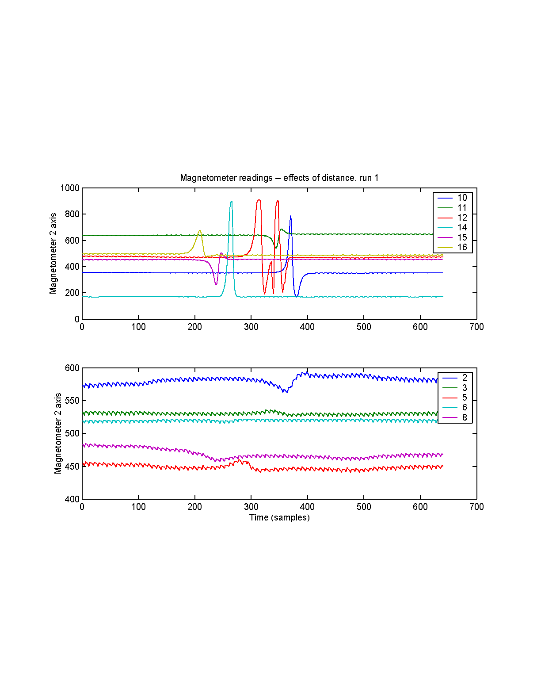
Magnetometer data

Slide 6
Why calibration
Account for difference in sensitivity
Detect stationary vehicles
Perform more sophisticated estimates
Predict detection radius

Slide 7
Calibration components
Defining an absolute scale
Finding a zero
Finding a response to a known stimulus

Slide 8
Absolute scale
Instrumentation amps not rail-to-rail
  Valid reading range – 300~700 ADC units
1 potentiometer step ~ 140 ADC units
  Potentially 4 steps of the potentiometer produce a valid reading
  In the measurement process, actively change the potentiometer setting, record the difference
  Use tabulated differences to produce a single value across all potentiometer settings

Slide 9
Zero response and sensitivity estimation
Observation: we already have a well measured source of magnetic field – Earth
  Magnitude ~0.25 gauss, direction ~ north
  Constant for our purposes
  Available in most environments
Spin the magnetometer
  Each magnetometer axis measures the projection of Earth’s field onto the sensor
  Each full turn produces a sinusoid
    Frequency = turning speed
    Amplitude = 2* response to 0.5 gauss
    Offset = response to a 0 gauss field

Slide 10
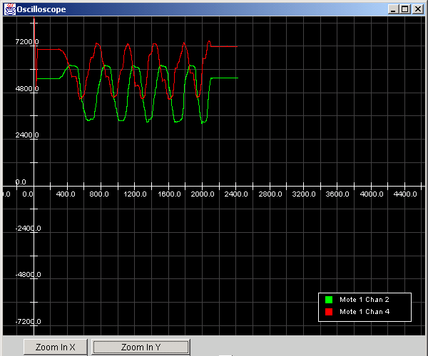
Initial calibration results

Slide 11
Calibration sanity checks
Phase difference
  Axes are 90 degrees out of phase – good
Magnitude of response
  Magnitude constant throughout the rotation
    In the future, use that to detect flawed readings
  Predicted: 11120 ADC units
  Measured: ~6000 ADC units
  Good: we expect sensitivity to degrade w/o external sensor reset, measured is smaller than predicted, reasonably constant across initial sample of boards
  Bad: only half the sensitivity of the sensor

Slide 12
Deliverables
Magnetometer calibration component
  Produce readings on an absolute scale, with a consistent scale across the boards with a fixed zero point
  Initialize with a message, require spinning the magnetometer
Increasing the sensitivity
  Set/reset board
  Run a current pulse through the sensor to align the magnetic domains within the sensor to factory spec

